Slide 1
The Avenue School - Sensory Trail
Our outside spaces are a vital part of the education and development of the young people at The Avenue
They provide an area to play, to exercise, to learn about nature, to relax and to have fun
Break and learning times outside are much loved by our young people
Our sensory trail is in need of urgent repair and a substantial update so that we maximise the potential of the great space that we have available

Slide 2
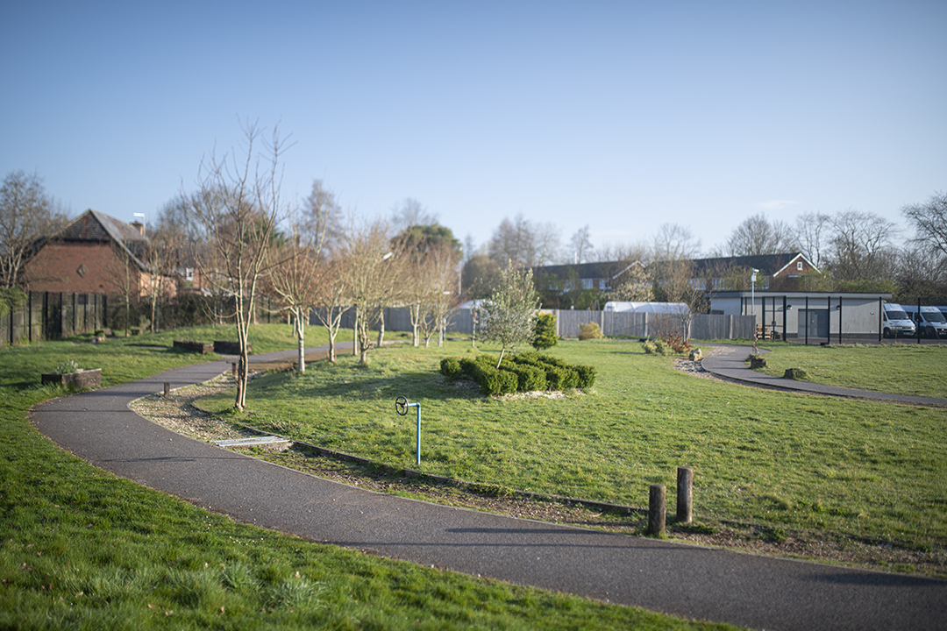
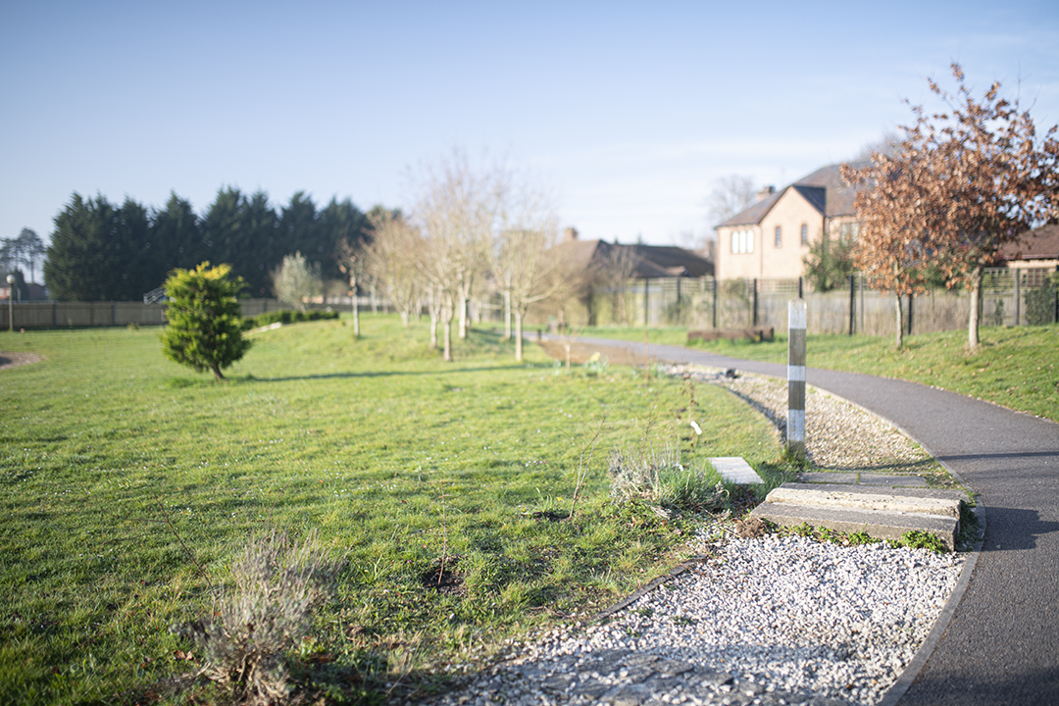
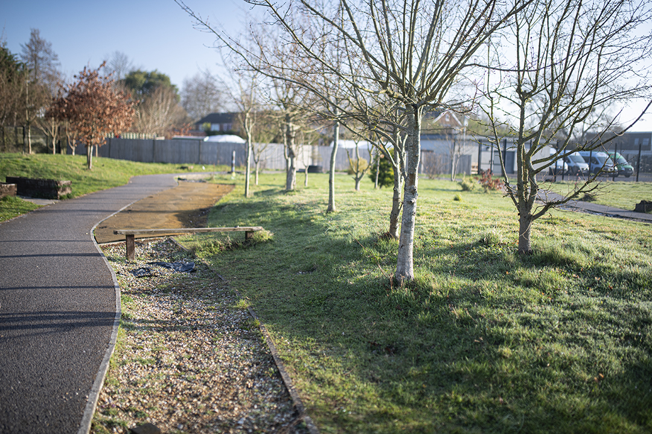
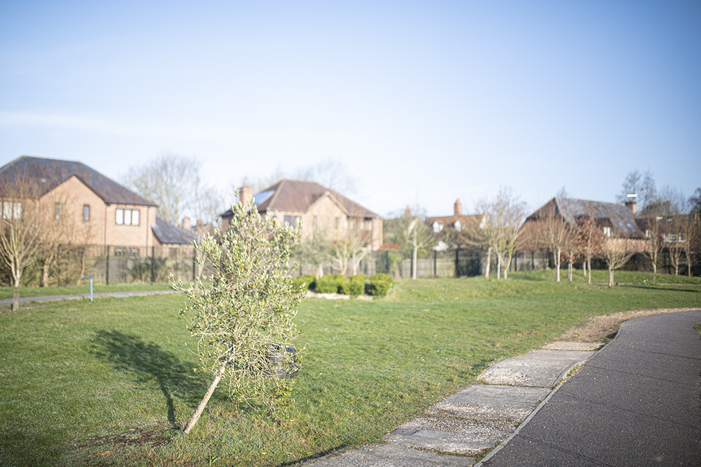
Sensory Trail

Slide 3
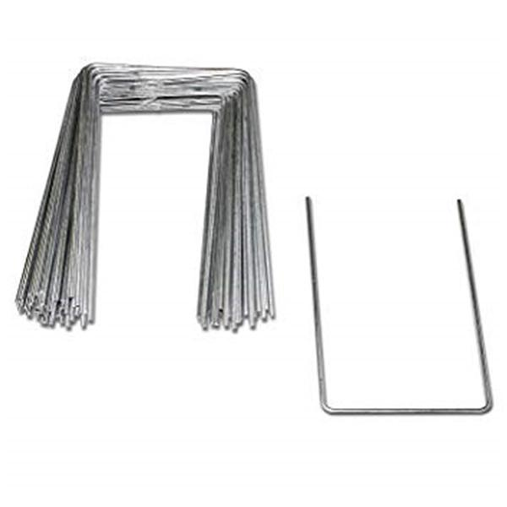
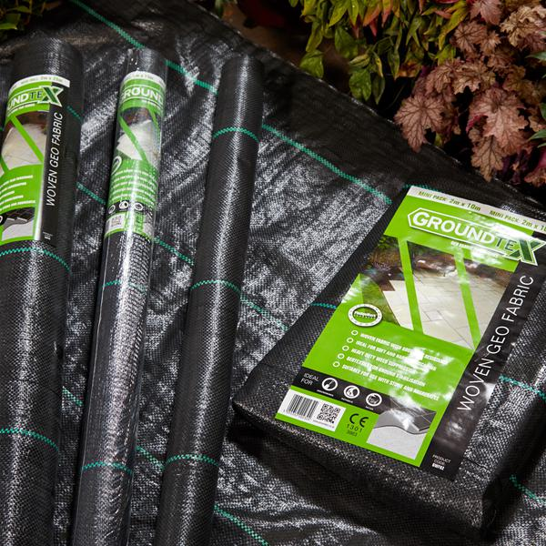
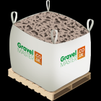
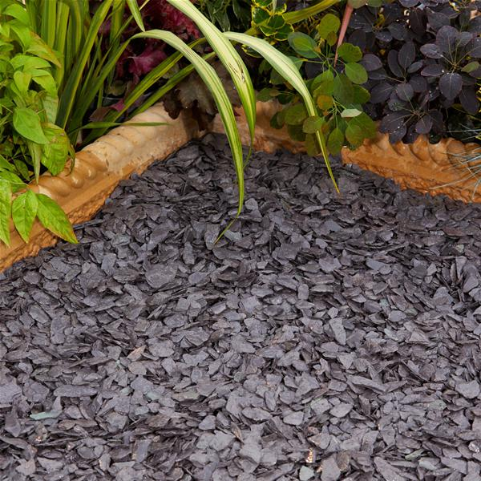
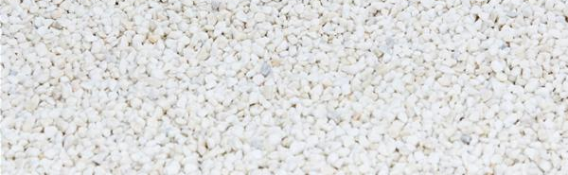
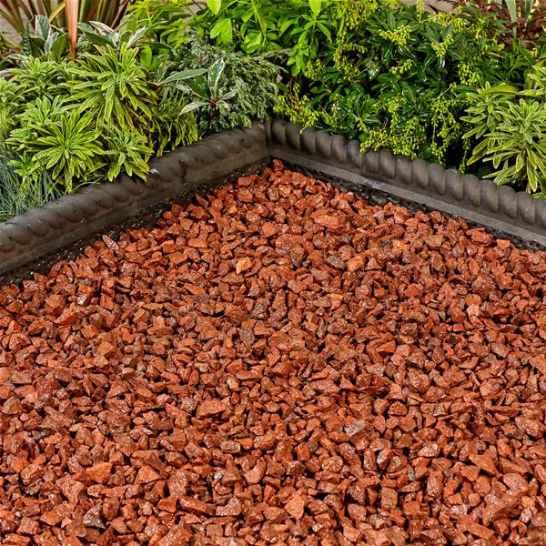
Phase 1 – Getting the area safe
Following the installation of a fence we now have the Sensory Trail area sectioned off from our main playground area. Our main priority is to make the it safe.
The actual trail of the sensory garden is in desperate need of being re lined and filled. To do this it will have to be dug out, levelled with top soil and lined and filled with stones.
To improve on the current Trail we will use rougher stones, Our young people collect and take the smooth pebbles and are known to pop them in their mouths. The area which has rough stones has been left.
We will also use contrasting colours to support our visually impaired young people as well as adding a bit more winter colour the space.

Slide 4
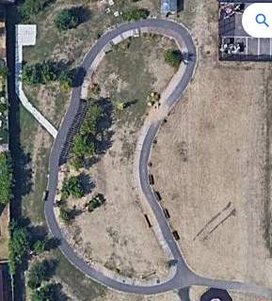


We want The Sensory trail to be a multi-functional area that benefits all of our school community
In order to that we will aim to provide different areas that provide different stimulus to reflect the different needs each of our young people require

Slide 5
Phase 2: Specific areas
We want to make the sensory trail as user friendly as possible. By creating areas based on our senses, we give the young people the opportunity to interact and explore nature. Having a truly interactive trail will draw the young people in.
Sight | Touch | Sound | Taste | Smell | Vestibular | Proprioception
Colourful planting, mirrors and equipment. Water. | Planting which has different textures. Water. | Water. Planting such as bamboo which softens playground noise. Sounds wonderful when the wind travels though. | Not encouraging young people to put things in their mouths however planting safe plants which could be used in food tech. | Planting with plants which are robust and can be crushed under foot and wheels | Playground, Swing and equipment | Playground, Swing and equipment.

Slide 6
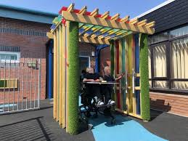
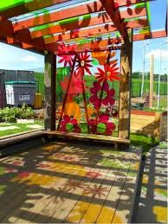
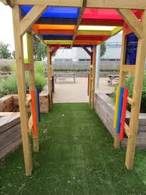
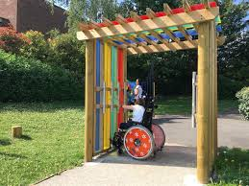
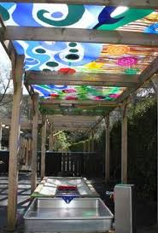

Slide 7
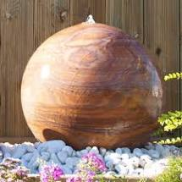
Why:
Wonderful sensory experience for all.
Great for Well-being! Young people can sit and watch/listen to the water and the different colours as they change on the marble.
Fabulous for our wildlife.
When asked the staff and children all said they would love to see a water feature.
Safety:
Water can be turned off.
Water cascades and doesn’t pool.
It is very heavy so can’t be pushed over.

Slide 8
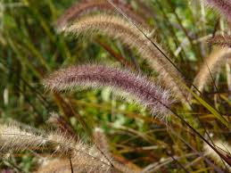
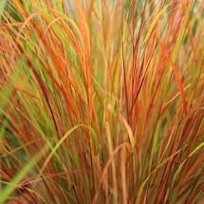
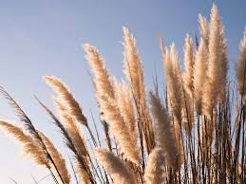
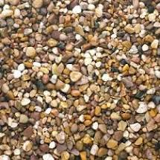
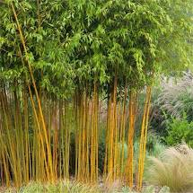
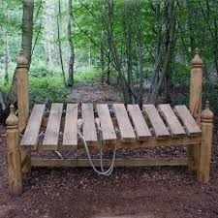
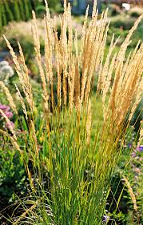
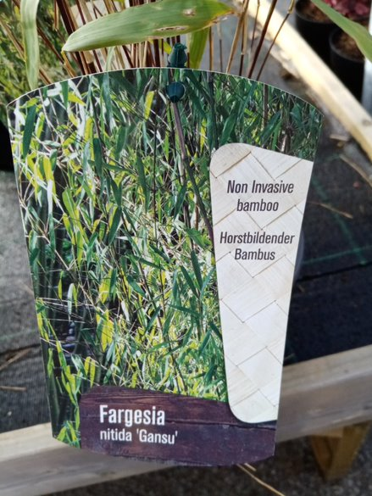
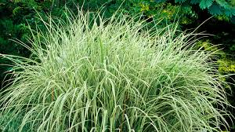

Slide 9
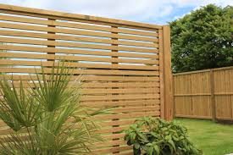
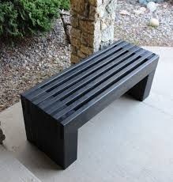
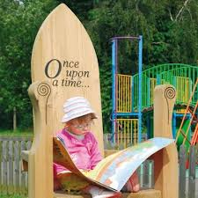
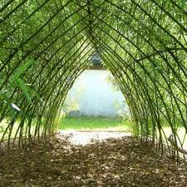
Reading Garden Area

Slide 10
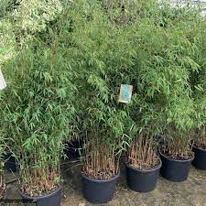
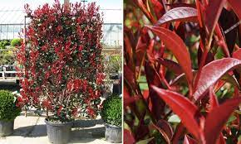
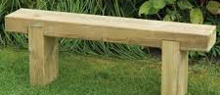
Water Feature

Slide 11
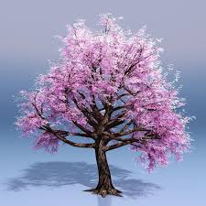
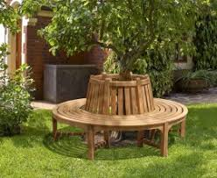
Memory Tree
The Memory Tree is a really important part of our Project. We want to have a quieter area for the young people,staff and parents to remember the friends and colleagues we have lost

Slide 12
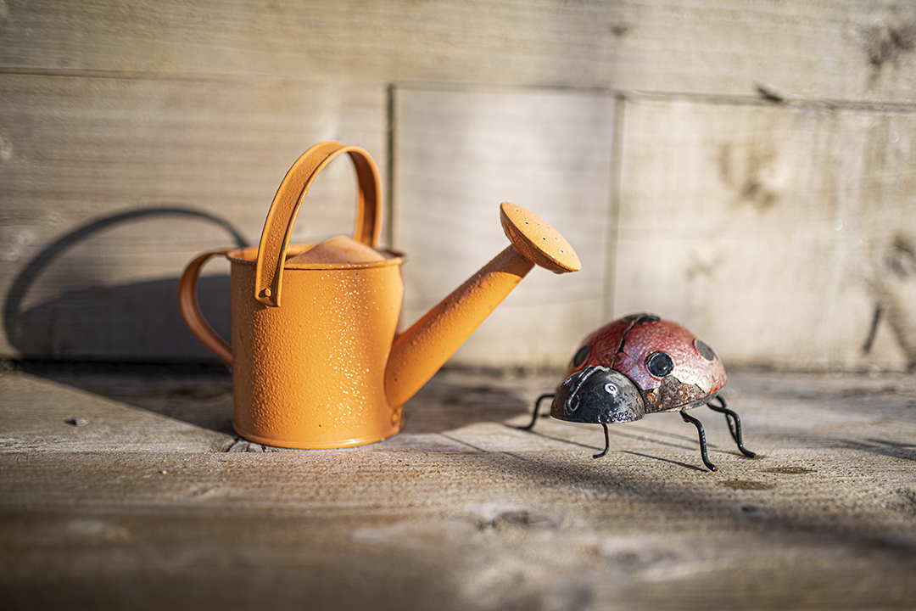

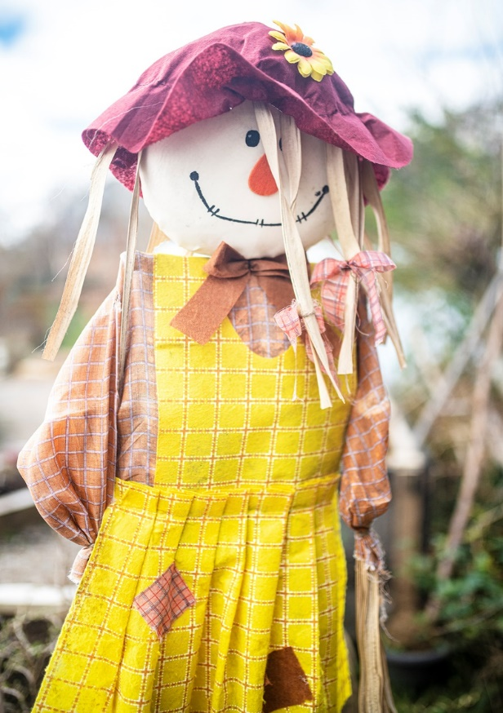
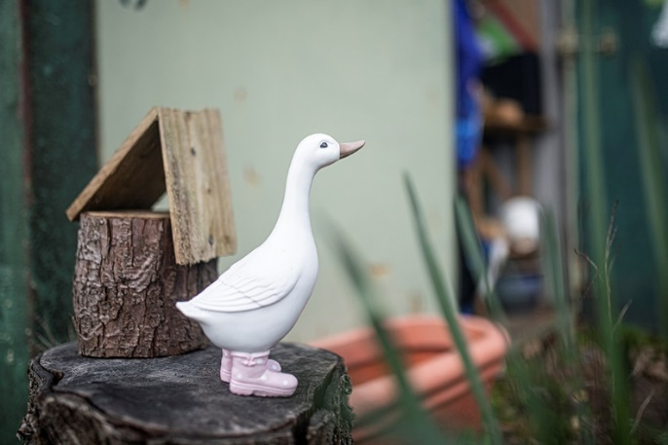
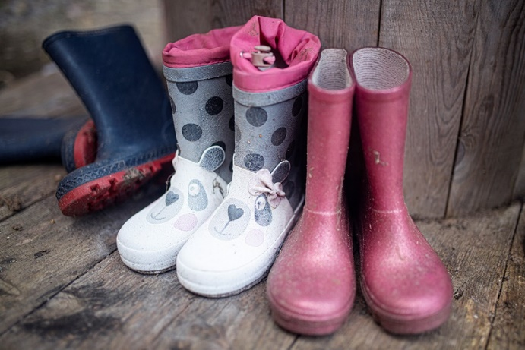
Fund Raising Goal
£10,000

